Slide 1
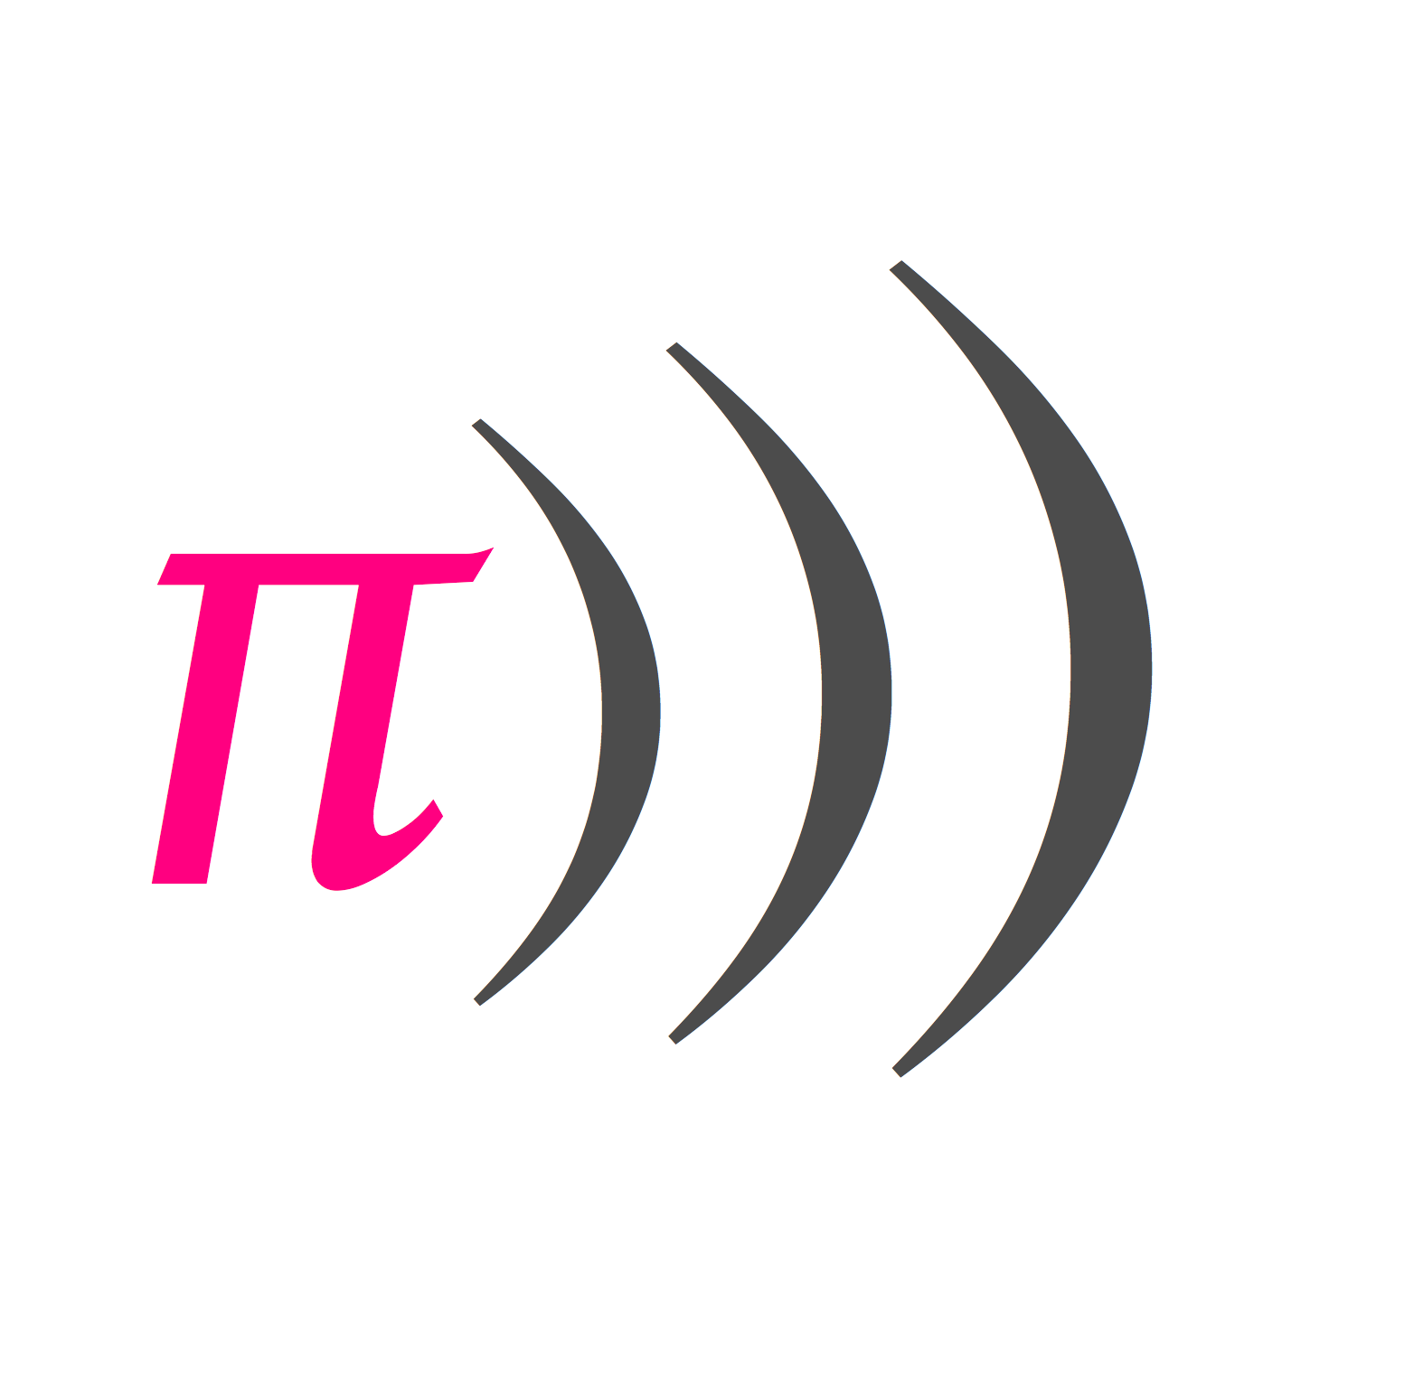
An Introduction to Sonic Pi
Notes:
Adapted from the fantastic worksheet here: https://www.raspberrypi.org/learning/getting-started-with-sonic-pi/worksheet/

Slide 2
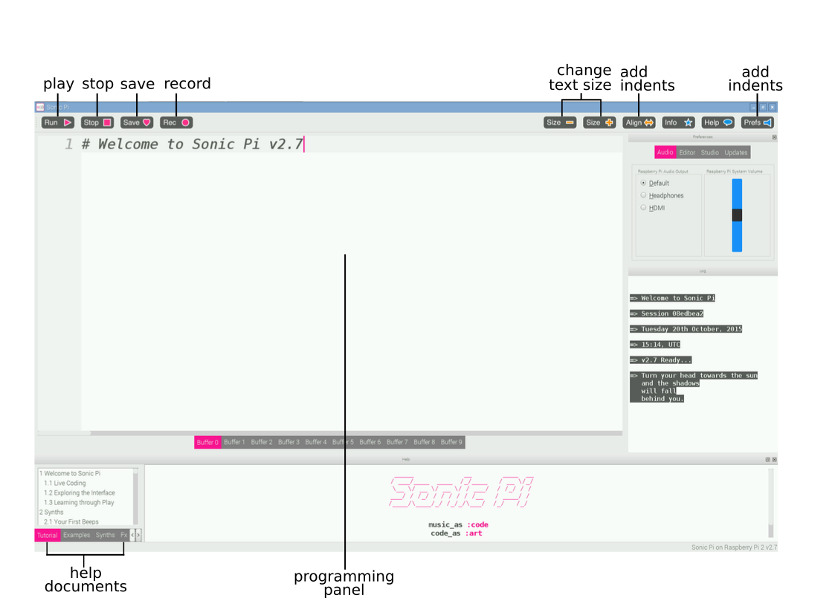
The Interface
Notes:
This is the Sonic Pi interface; it has three main windows. The largest one is for writing your code, and we call it the Programming Panel. There is also an output panel that displays information about your program as it runs. When you click on the help button at the top of the window, the third panel appears along the bottom displaying help documentation. This contains information about different code you can try and use, as well as different synth sounds, samples, and much more.
Launch Sonic Pi from the menu under Programming

Slide 3
Make some sounds
play 60
play 60
sleep 1
play 67
sleep 1
play 69
pley 60
play 60
play 67
play 69
Notes:
Select Buffer 1 and type: (click to show)
Click on the play icon at the top of the screen. What happens?
What happens if you type: (click to show) and click on the play icon?
This is an example of a bug in your code. In later activities, if the error panel displays text you will know that you have a bug that you need to fix. It could be that you have misspelt a word like play.
Now type: (click to show)
Click on the play icon at the top of the screen. What happens?
The computer is playing each note in sequence (one after the other), but it is happening so fast that to us they sound like they are playing at the same time.
We need to tell the computer to pause between each note. We can do this by typing the following after each play: sleep 1 (click to show)
The value entered after the word sleep represents time in seconds. Using the value 1 represents one second. What would you type for half a second?
Now write a sequence of play and sleep to make a cool-sounding tune!

Slide 4
Loop a tune
2.times do play 60 sleep 0.5 play 62 sleep 0.5 play 64 sleep 0.5 play 60 sleep 0.5 end
play 60 sleep 0.5 play 62 sleep 0.5 play 64 sleep 0.5 play 60 sleep 0.5
Notes:
Select Buffer 2.
Type the following code: (click to show)
Now click on the play icon at the top of the screen and it will play the first part of a tune. Can you tell what it is?
Answer: Frère Jacques!
This first section plays twice. How could you repeat it? You could type the same section out again, or we could start to introduce loops to your code.
At the top of your code, above the first play 60, type: 2.times do
And at the bottom of your code, below sleep 0.5, type: end (click to show)
Click on the play icon at the top of the screen. What happens?
Let's play this part in Sonic Pi.
In the example below, you can see that some lines of code are indented. This makes it easier to read your code, and check for any bugs if it does not work when you press the play button. You can press the space bar twice to indent a line of code, or when you run your code for the first time, Sonic Pi will indent it for you.

Slide 5
Music Notes
play :c4 sleep 0.5 play :d4 sleep 0.5 play :e4 sleep 0.5 play :c4 sleep 0.5
C | D | E | F | G | A | B
60 | 62 | 64 | 65 | 67 | 69 | 71
Notes:
The values that you have been typing after the word play represent notes; in fact, they are MIDI note numbers. This means we can translate songs played on a piano into Sonic Pi using a table like so… (click to show)
This is quite a long process if you know the notes of the song you are trying to play. With Sonic Pi you are able to use standard sheet music notation too.
In a new buffer tab type (click to show)
Notice the colon before the note name, without this it will not work. The number after the note name represents the octave which it is played from; you do not have to provide this.
Press play to hear your tune. Does it sound the same as when you used MIDI notes?

Slide 6
Change the Sound
use_synth :fm 2.times do play 60 sleep 0.5 play 67 sleep 0.5 end
Notes:
It's time to make your tune sound more interesting! We can do this by changing the synthesizer sounds it is using. The default Sonic Pi synth is called beep.
To use a different synth, you need to add the code use_synth :name of synth above the sequence of code you want to use it in.
In this example, fm is the name of the synth
There are lots of cool-sounding synths included with Sonic Pi. To find the names of them, click on the help icon at the top of the screen so that the help documents window appears. Then select Synths from the tabs along the left hand side of the help window. Click on any of the synth names to get more information on how to use it.
Try using some different synths and see what they sound like.

Slide 7
Repeated Phrases / Functions
2.times do play :c4 sleep 0.5 play :d4 sleep 0.5 play :e4 sleep 0.5 play :c4 sleep 0.5 end
define :name do play :c4 sleep 0.5 … end
name name
define :phrase1 do play :c4 sleep 0.5 play :d4 sleep 0.5 play :e4 sleep 0.5 play :c4 sleep 0.5 end
phrase1 phrase1
Notes:
Music often uses repeated patterns or phrases to make up a complete tune. We can use the loop to play a section of notes over a certain amount of times, but what if we want to play that same section later on in our tune?
We could write the code out again at the point we wanted to reuse it, but that would be labourious!
In Sonic Pi we can use functions to give a bunch of code a name and then use that code by just calling the name of the function at the point we want to use it. It is important to remember that Sonic Pi runs its programmes sequentially, which means “from top to bottom” or “in order”. For this reason you need to have defined your function before you try to use it.
Let’s look at the Frère Jacques! loop again (click to show)
We can define this as a function and then call it twice by adding define :name do at the start of the note block and end at the end. We would then just write the name of the function twice after the function definition to make it play. (click to show)
So let’s create the Frère Jacques! as a function called phrase1 and run it. (click to show). You could now reuse this block of code at any point in your tune just by writing phrase1.
With this basics you should now be able to start writing tunes in Sonic Pi!

